Slide 1
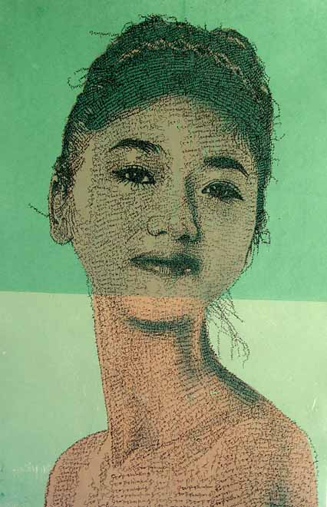
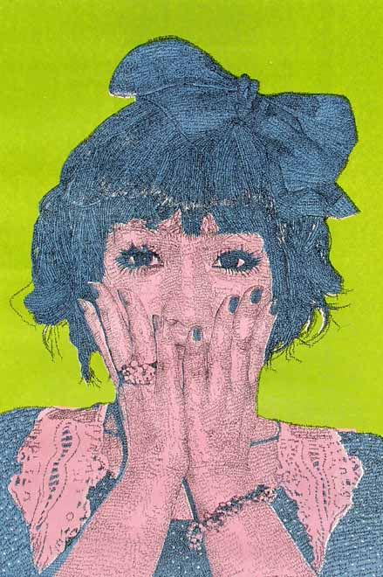
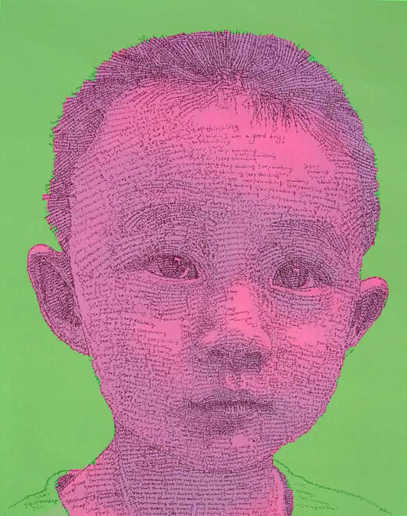
Yr 10 Art Summer Project

Slide 2
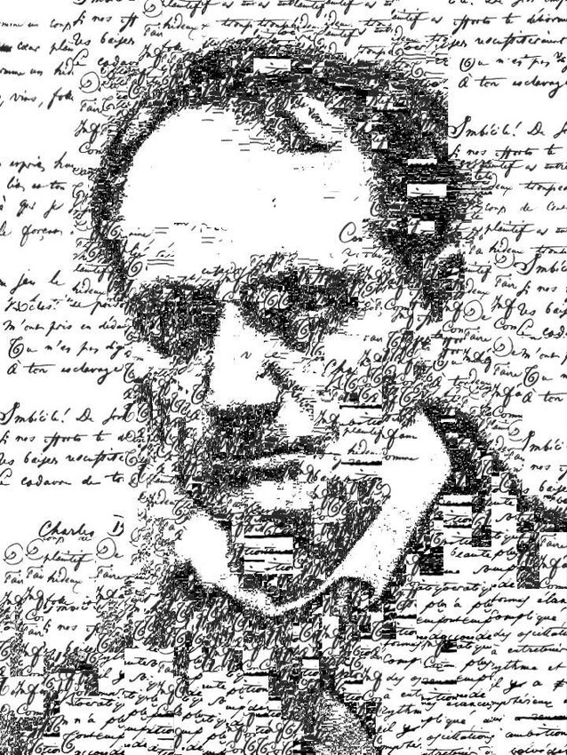
Portraiture – The Human Face
In preparation for the start of Year 11 in September and to use the skills you have learnt in Year 10.
Task: Combine your knowledge of contrasting colour theory and marks by Sergio Albiac to produce a portrait inspired by the Chinese Artist Weiping.
To be a success:
Draw from your own photo
Use contrasting colours
Show mark making skills
Consider the words and how they link to the person
Due: First lesson back at school.

Slide 3
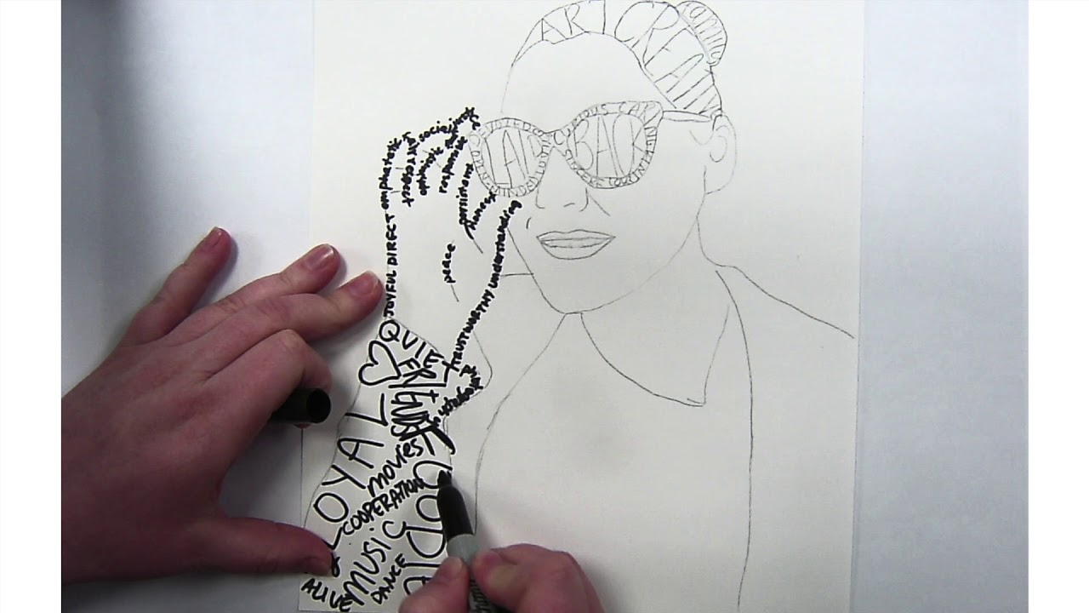
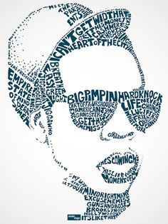
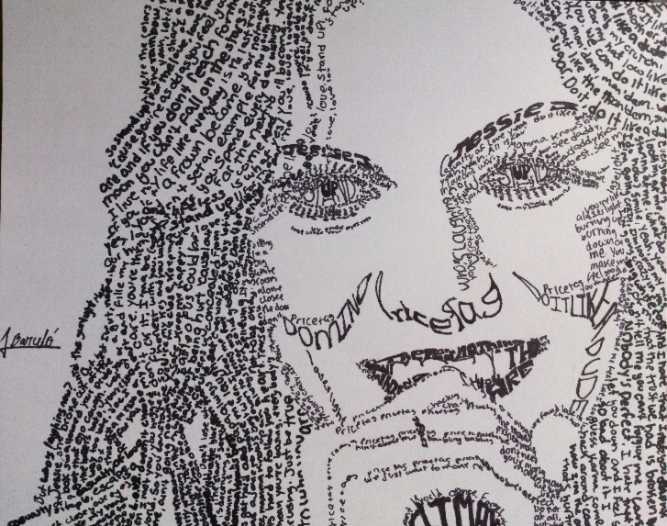
A Caligram is a word or piece of text in which the design and layout of the letters creates a visual image related to the meaning of the words themselves.

Slide 4
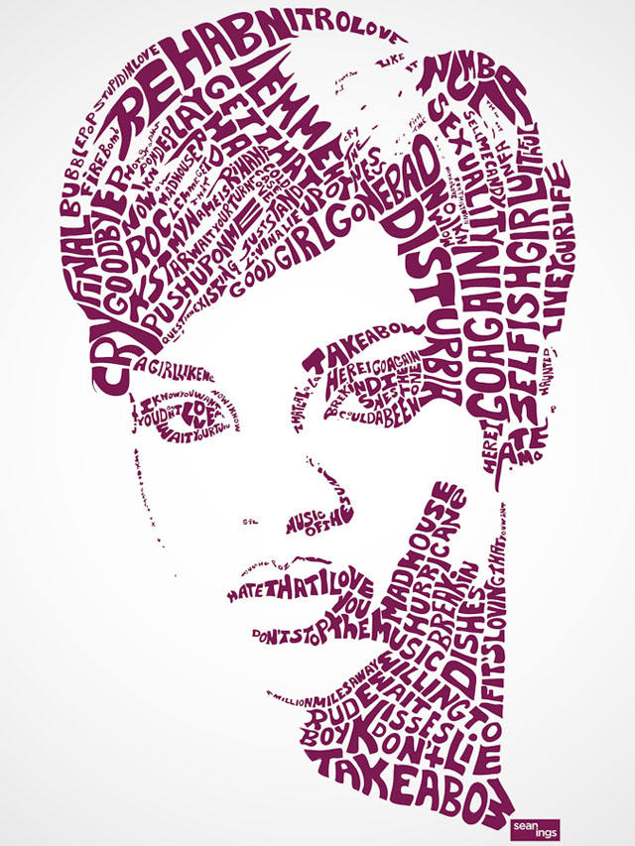
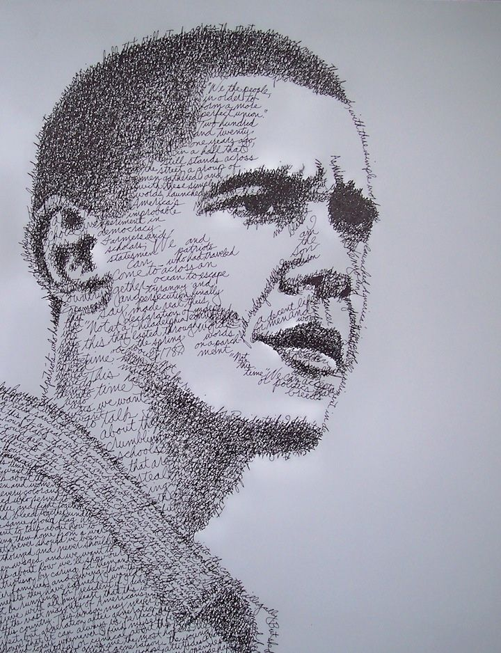
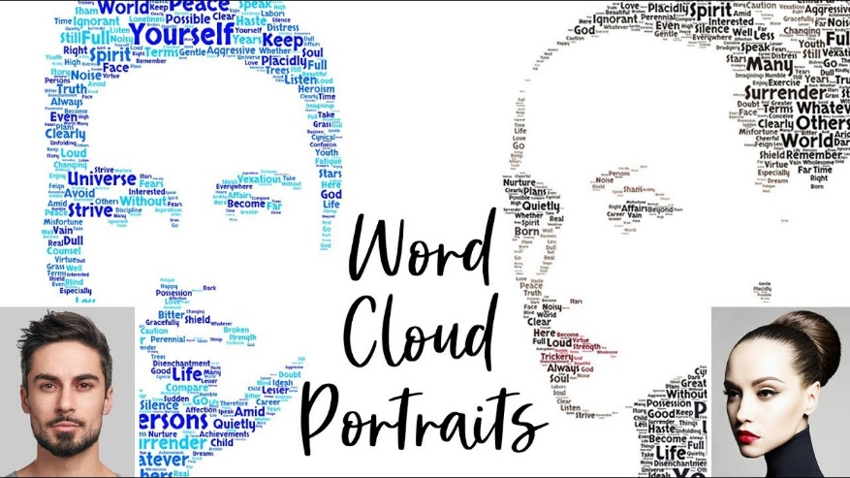
Caligram portraits

Slide 5
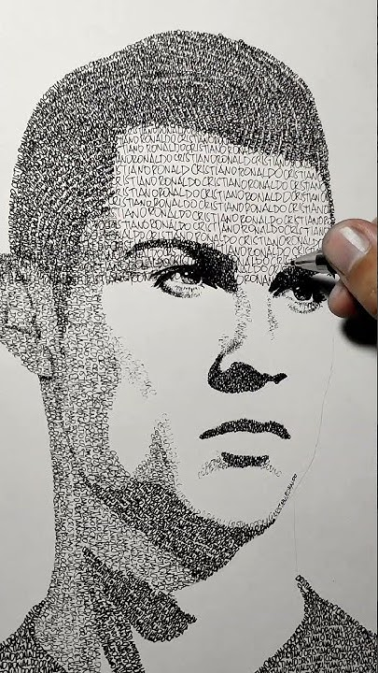
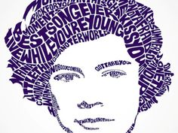
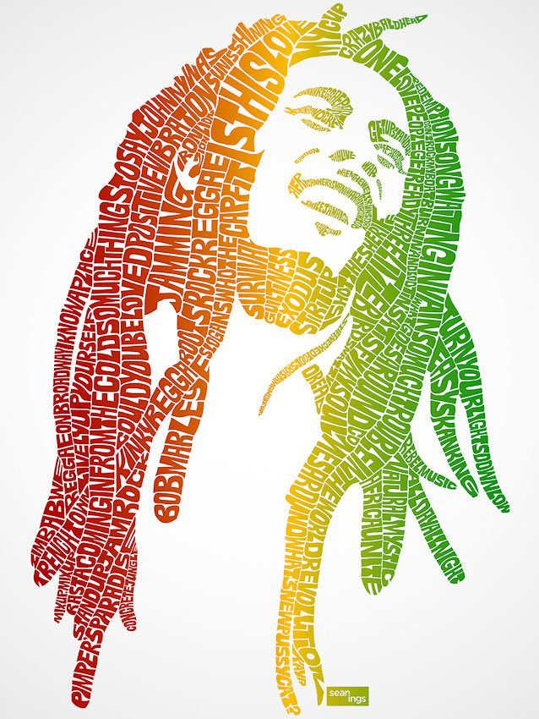
Caligram portraits

Slide 6
Artist Websites Starter: Look on the websites below for inspiration when completing this task.
Weiping:
https://sunart108.com/category/silk-screen/
Sergio Albiac:
https://www.sergioalbiac.com/wall/artists-self-portraits.html

Slide 7
Weiping

Slide 8
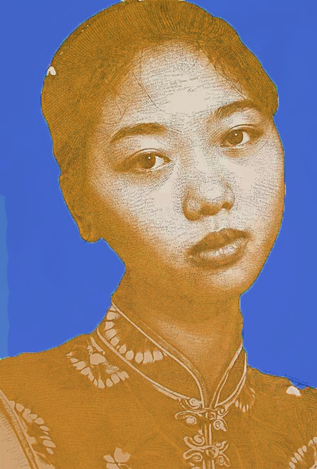
Weiping has used the words ‘young love and happiness’ as marks. She has repeated this sentence to create the different tones in the artwork.
Contrasting colours –
One colour for the face and one colour for the background.
In this image Weiping has chosen a contrasting colour combination of Orange and blue

Slide 9
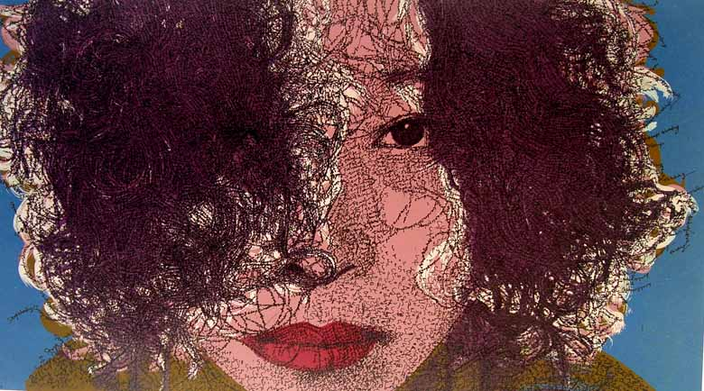

Slide 10
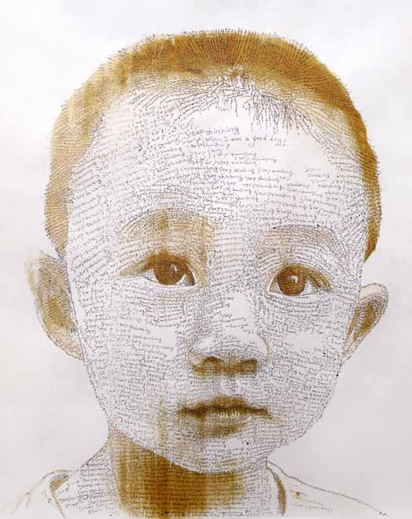

Slide 12
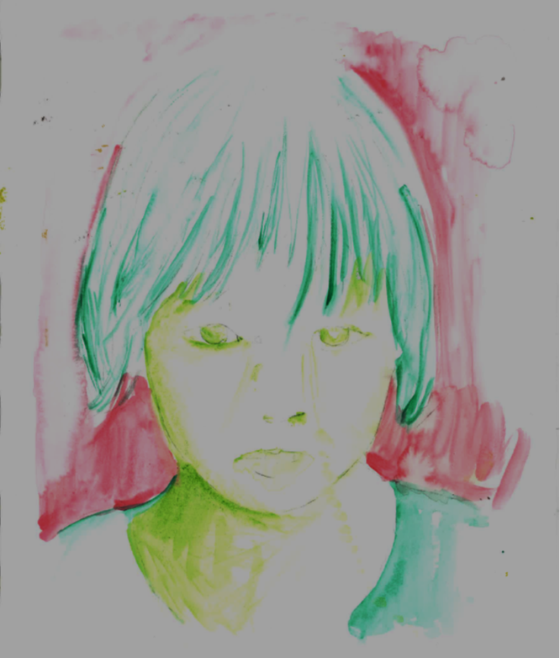
Step 1
Using your knowledge of drawing and colour theory, select and draw a portrait photograph you have taken (or use celebrities attached). Add colour to the drawing using a set of contrasting colours. Use one colour for the background and one colour for the face. No colours? Focus on Step 2.

Slide 13
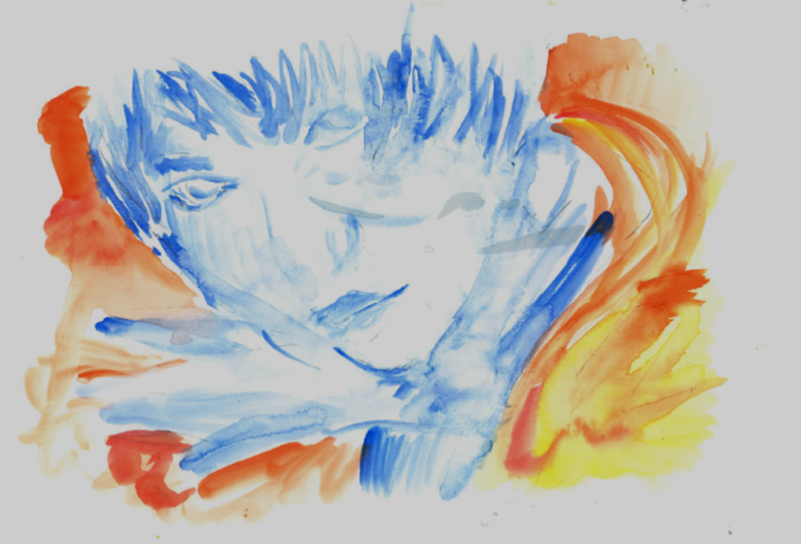

Slide 14
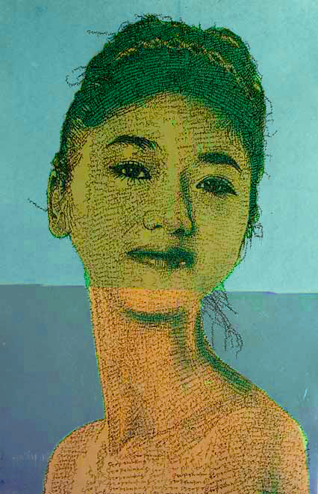
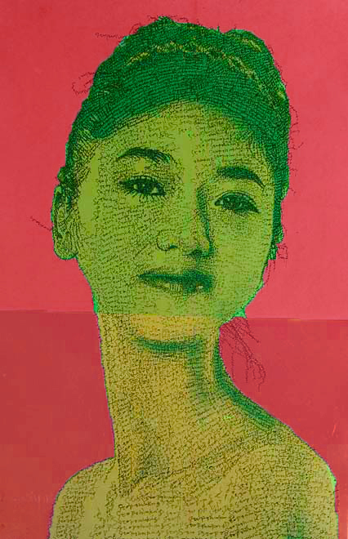

Slide 15
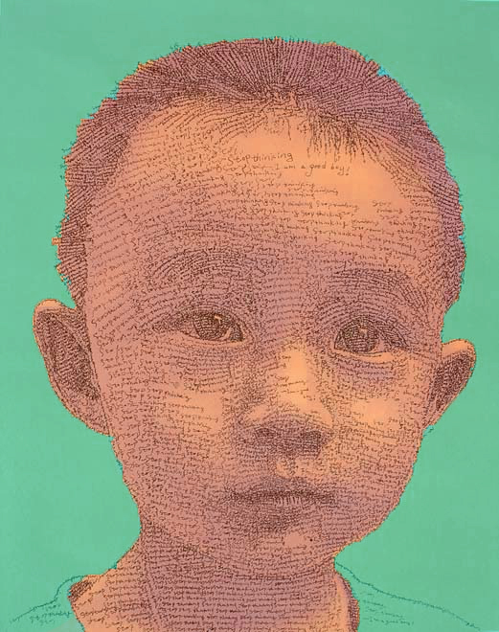

Slide 16
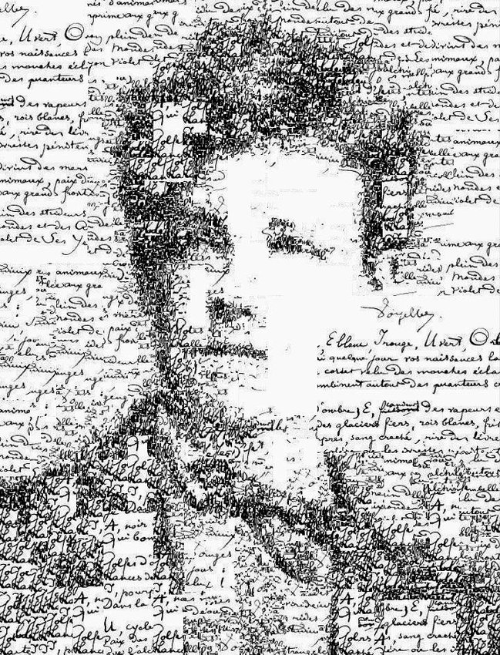
Sergio Albiac

Slide 17
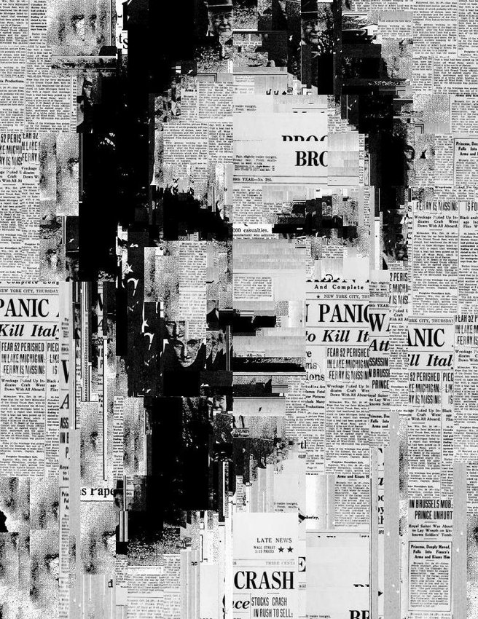
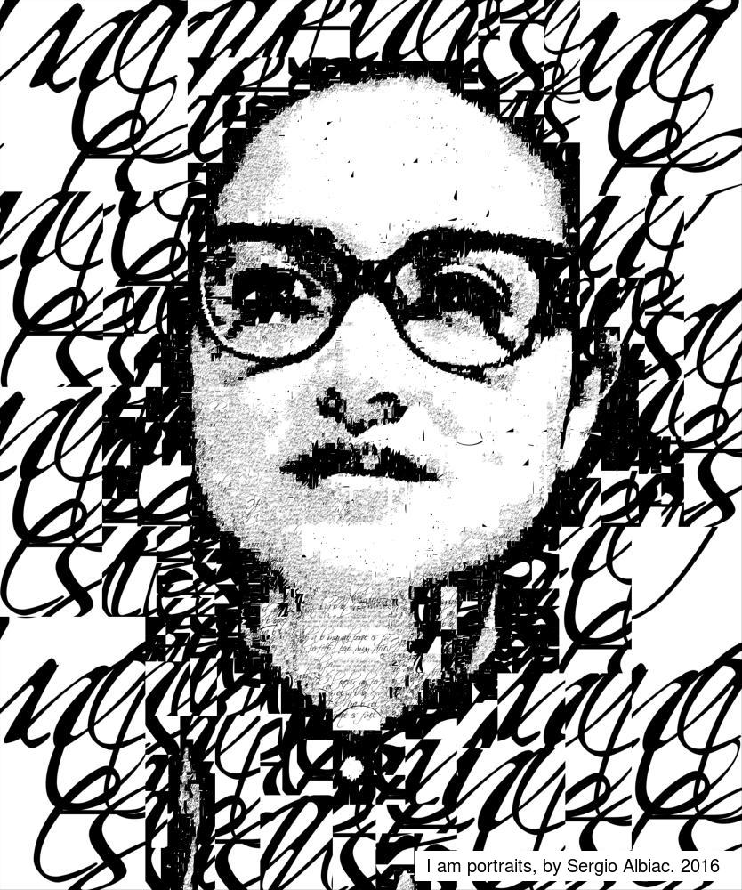
Sergio Albiac

Slide 18
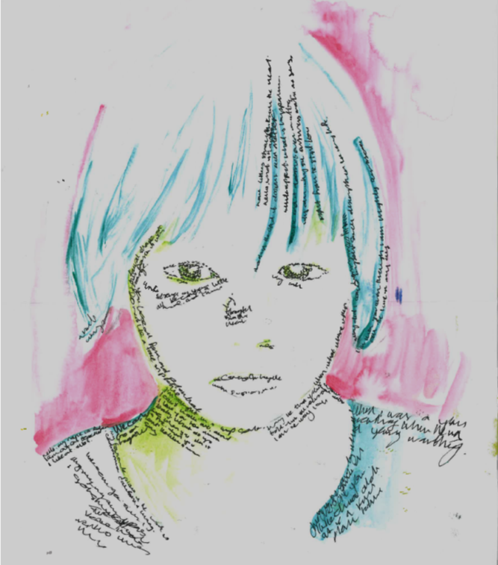
Step 2
Having looked at Sergio Albiac & Weiping now add words to your image using mark making. Could the words be linked to the person in the photograph?

Slide 20
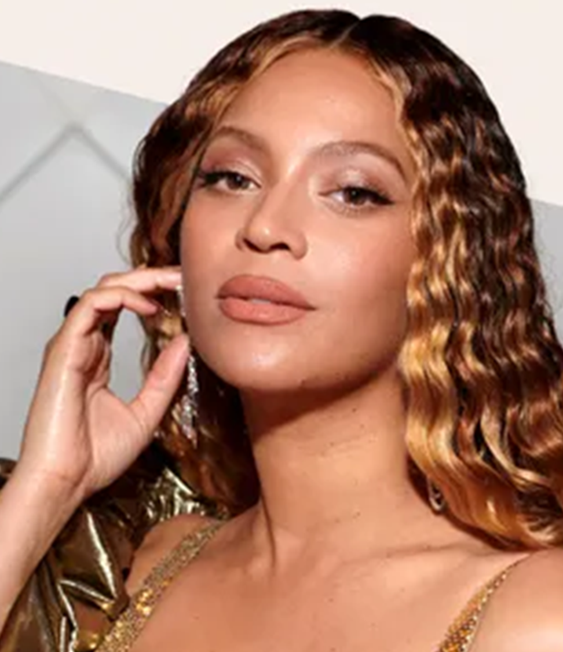
No photos? Choose one of these celebrities to draw from…

Slide 21
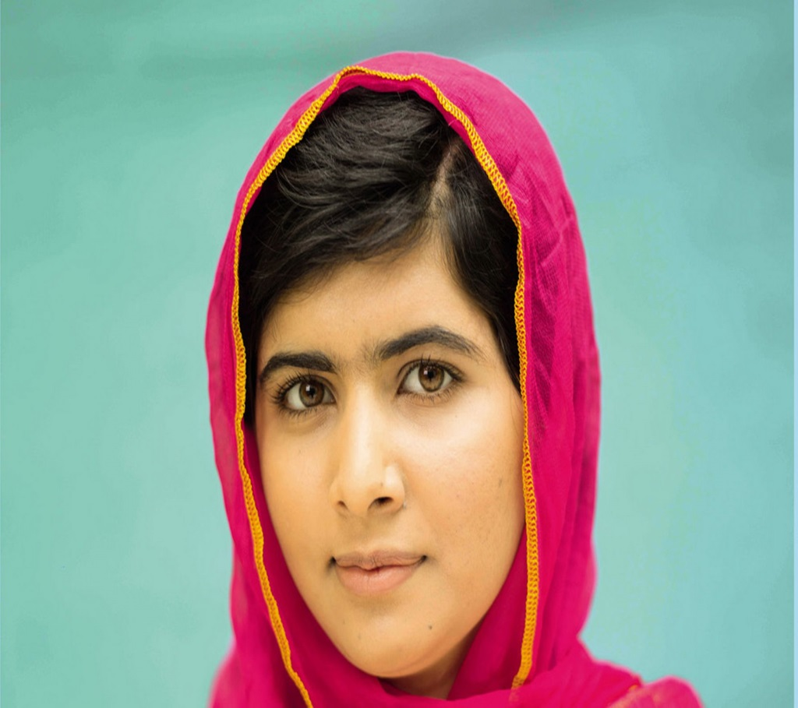

Slide 22
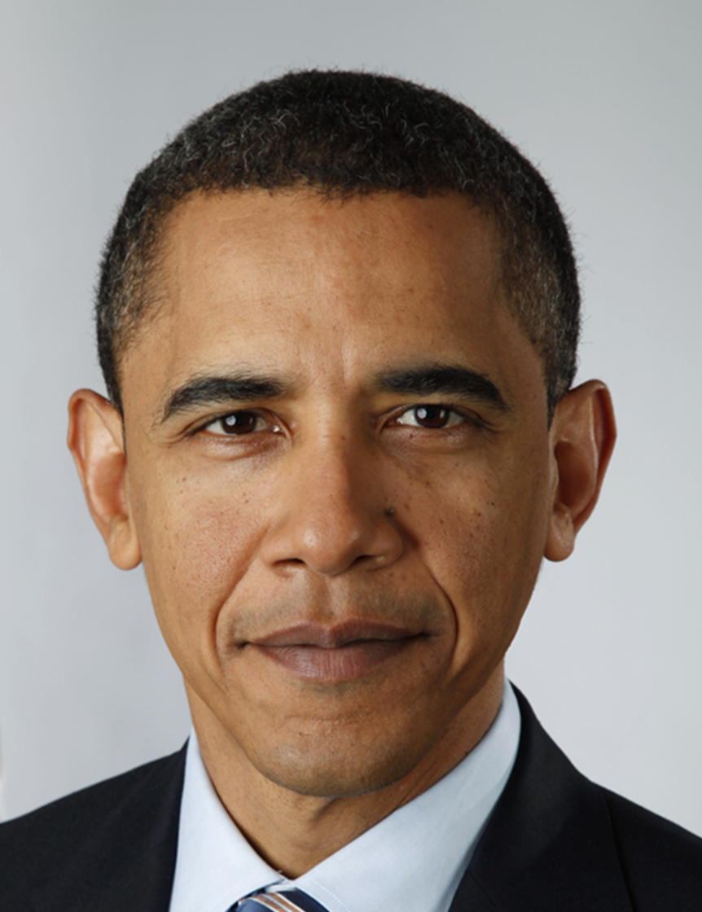
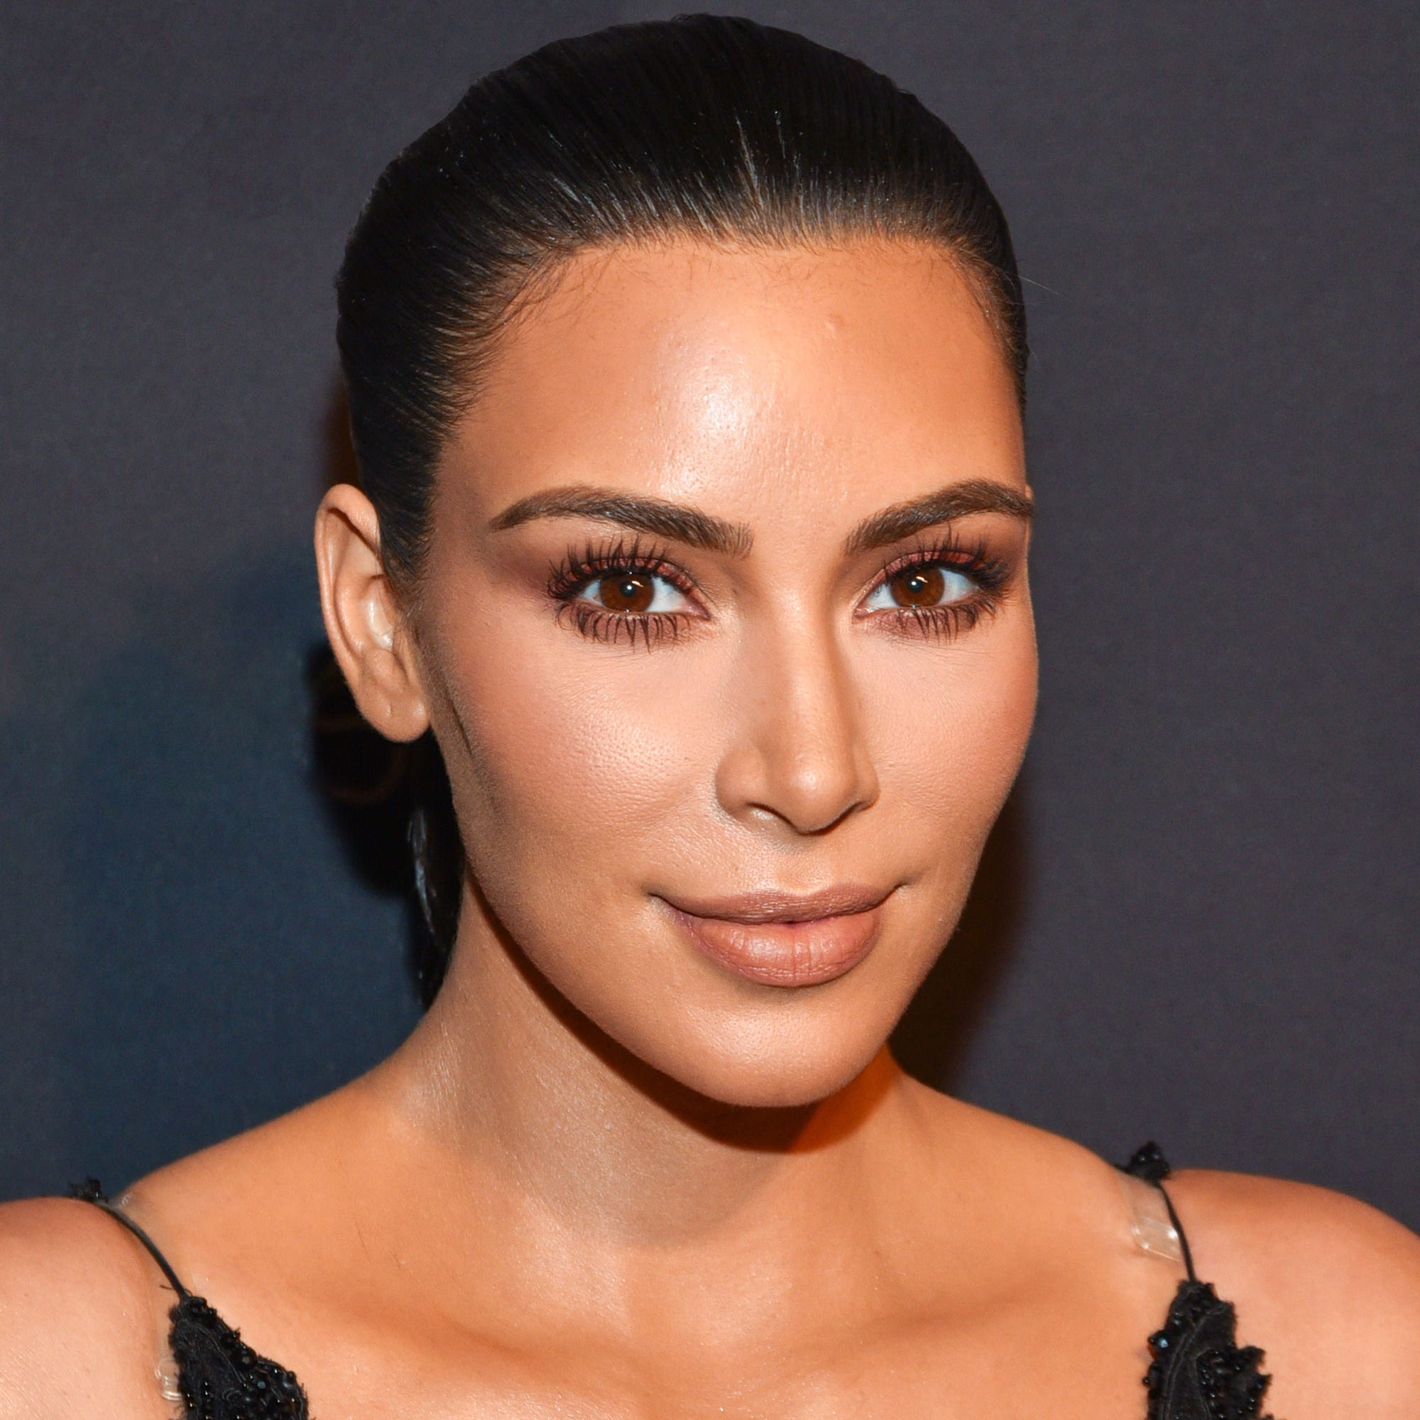

Slide 23
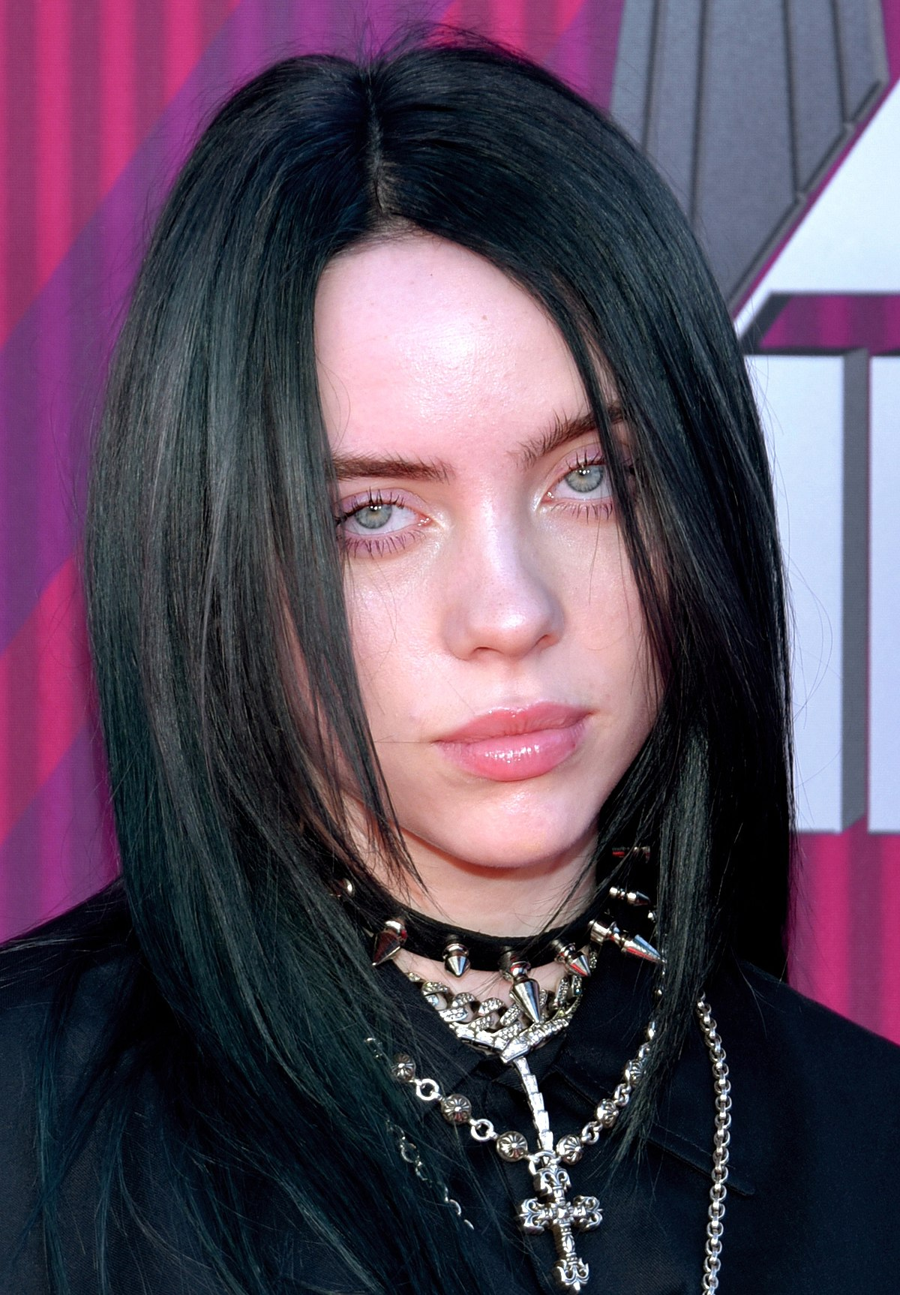
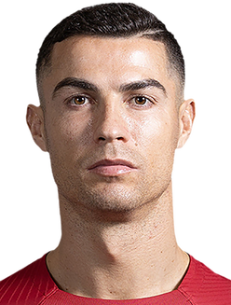

Slide 24
